Slide 1

B.Tech Project Evaluation-2, VIIIth Sem
Citizen Feedback on Maintenance of Road(Complaint Box)
Presented by :-
Arqam Jamal Ansari, 2018005658
Chirag, 2018001866
Gaurav Gambhir, 2018013133
Lalit Sharma, 2018010284
Under the Supervision of:-
Ms. Jyotsna Seth
Sharda University, Gr. Noida
DEPARTMENT OF COMPUTER SCIENCE & ENGINEERING
SCHOOL OF ENGINEERING AND TECHNOLOGY
02, April, 2022
1

Slide 2
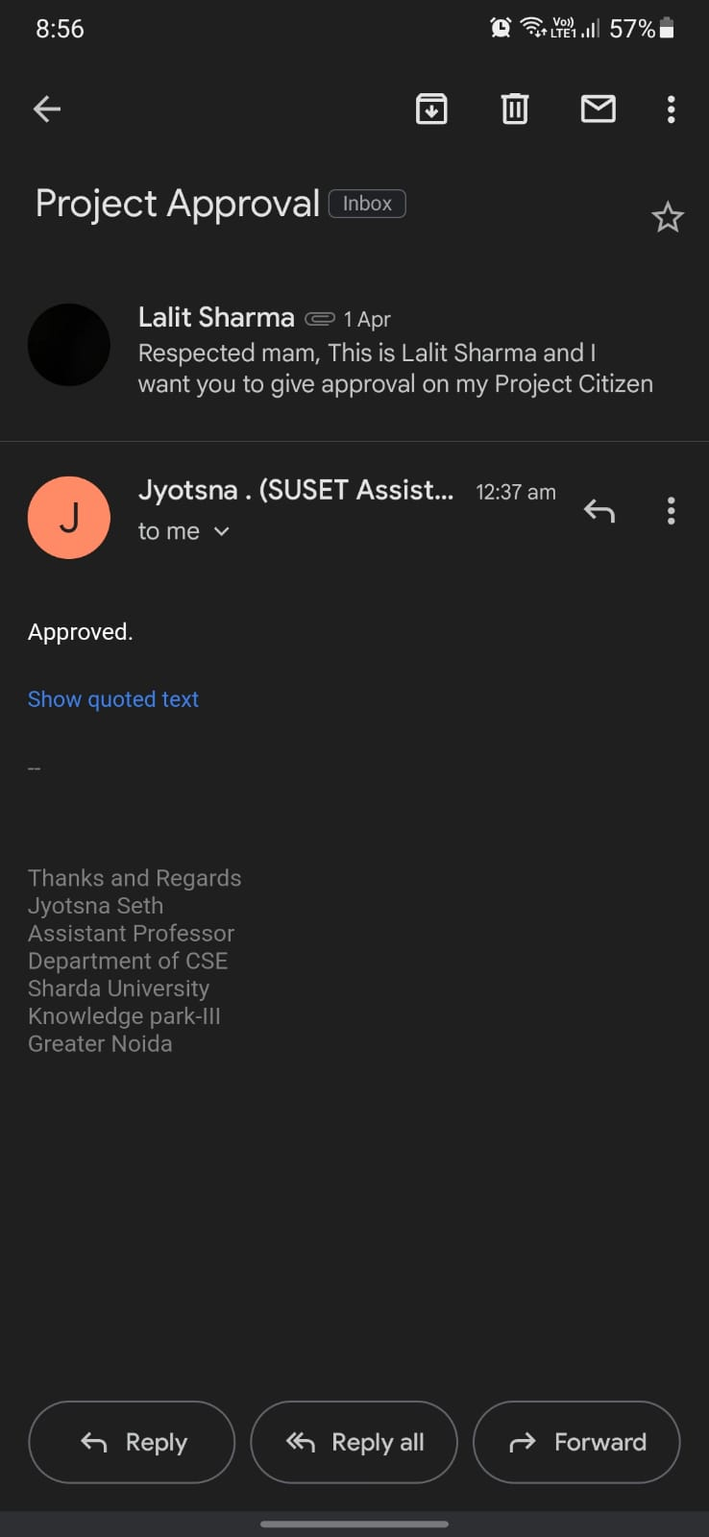
Approval from guide for the evaluation

Slide 3
Abstract
Citizen Feedback application will provide an online way for citizen to give feedback or complaints for the maintenance of roads and other necessities. The Main objective of Citizen Feedback app is to make feedbacks or complaints easier to resolve, monitor and coordinate. This android app will provide a user interface to submit a complaint and follow it. Our App will provide citizens to submit complaints and problem to municipal corporation and let them solve the problem in less time. Citizen feedback will help the system or department to continuously improve their work and do their best for the citizens, an effort to identify the changes that needs to be done. After the complaint has been raised, complaint will be assigned to their respective department. Once the complaint is submitted citizen can check status there of complaint.

Slide 4
Project overview:
Citizens have to register himself on application with their Phone/Email.
After registration citizen will be directed to home screen where citizen can select the department in which they want to raise the complaints.
Then citizen will need to enter details of the issues/ problems.
After the submission of the complaint citizen can check the status in my complaint.
After the complaint has been raised, complaint will be sent to the respective department.
After the department receive the complaint, they will monitor and resolve the problems as soon as possible.

Slide 5
Workload distribution of the team
NAME | WORKLOAD
Arqam Jamal Ansari | Design and Implementation
Chirag Khurana | Electricity, Municipal Corporation, Security
Gaurav Gambhir | Transport, Medical Care, Education
Lalit Sharma | Implementation and Testing

Slide 6
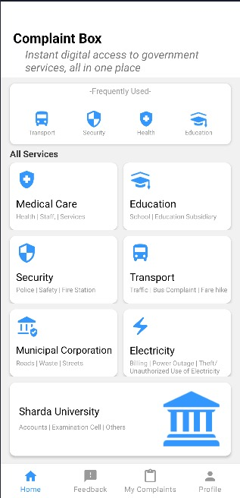
Improvement/Work done from the last evaluation
Completed all departments mentioned earlier
Implemented My Complaints fragment
3. Research paper submitted to IEEE conference
Names of department completed:
i) Electricity
ii) Security
iii) Education
iv) Medical Care
v) Municipal Corporation
vi) Transport

Slide 7
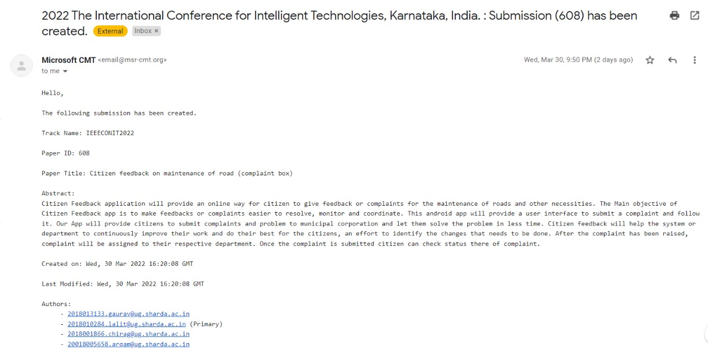
Proof of paper accepted or communicated/ Hackathon/ Patent

